Slide 1
Intro to Swing
Using Java Swing and MVC Design Pattern

Slide 2
Today's Overview
Git Exercise
Swing basics
Swing Exercise
More Downloads!!
Notes:
Source: http://en.wikipedia.org/wiki/Model%E2%80%93view%E2%80%93controller#mediaviewer/File:MVC-Process.svg
<number>

Slide 3
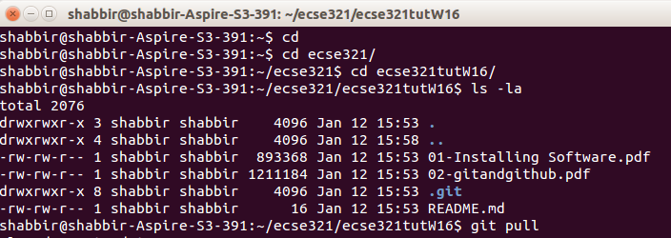
Get the latest material
Travel to tutorial folder
Check that you are in the Repo
Get latest files

Slide 4
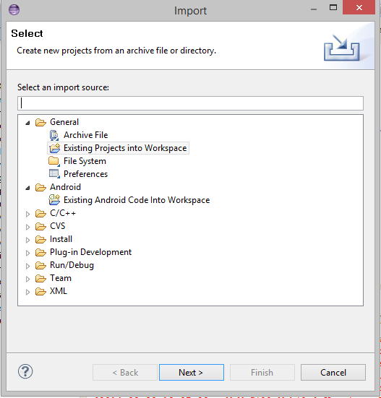
Importing a project
File -> Import -> Existing project into Workspace -> Browse for project
Go ahead and import today’s example code

Slide 5

Java Swing
The very basics

Slide 6
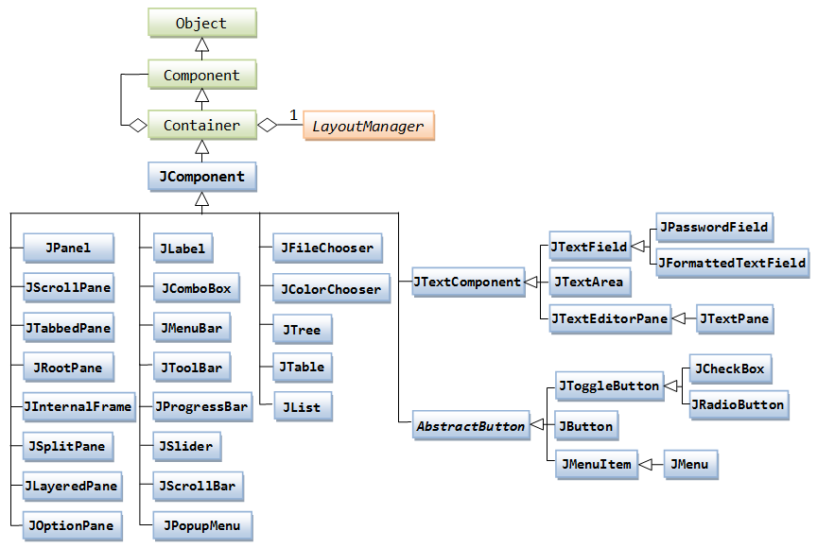
Java Swing
Java Swing is the library used to make Graphical user interfaces in Java
Notes:
Source: http://www.ntu.edu.sg/home/ehchua/programming/java/images/Swing_JComponentClassDiagram.png
<number>

Slide 7
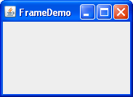
Swing Basics - JFrame
A JFame object is your window

Slide 8
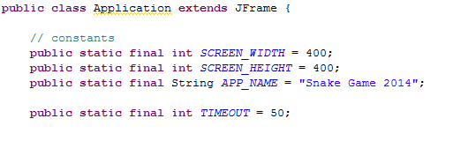
Swing Basics - JFrame

Slide 9
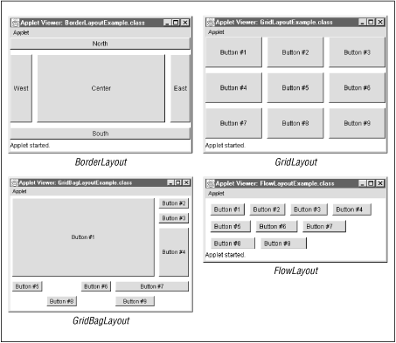
Swing Basics - Layouts
A layout is how components are placed

Slide 10
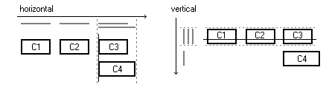
Swing Basics - Layouts

Slide 11
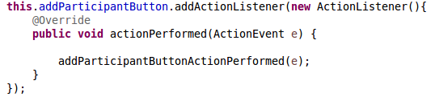
Swing Basics – Action Listener
Action Listener calls a method when a particular action takes place

Slide 12

Pair Programming exercise

Slide 13
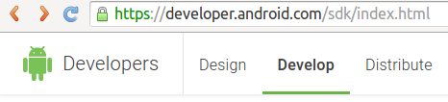
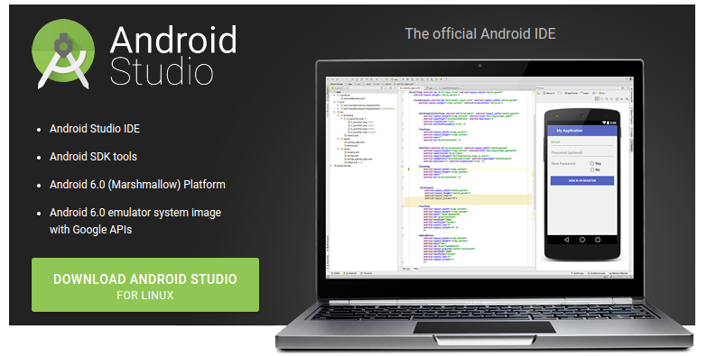
Android Studio
Follow Link
Download Tool
Notes:
Download Android Studio here:
https://developer.android.com/sdk/index.html

Slide 14
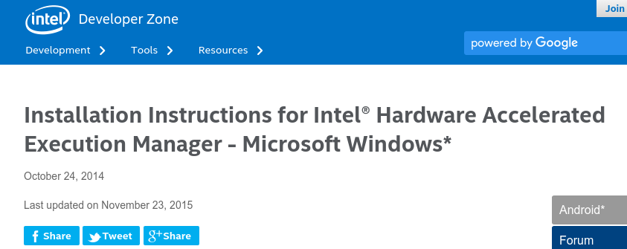
Get HAMX
https://software.intel.com/en-us/android/articles/installation-instructions-for-intel-hardware-accelerated-execution-manager-windows

Slide 15
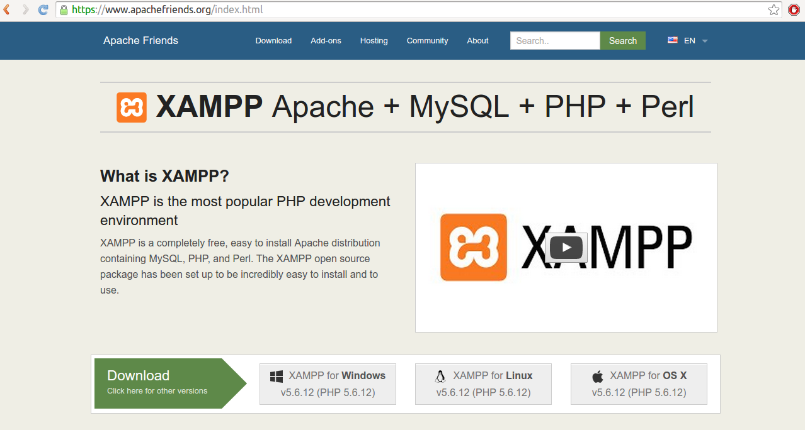
Get XAMPP
Go to www.apachefriends.org

Slide 16



The World Wide Web
Notes:
<number>

Slide 17
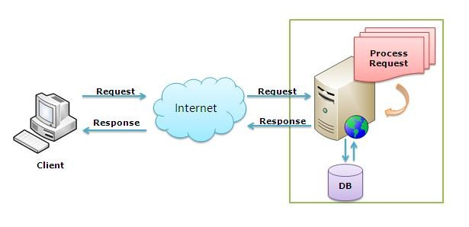
The World Wide Web
Notes:
<number>

Slide 18
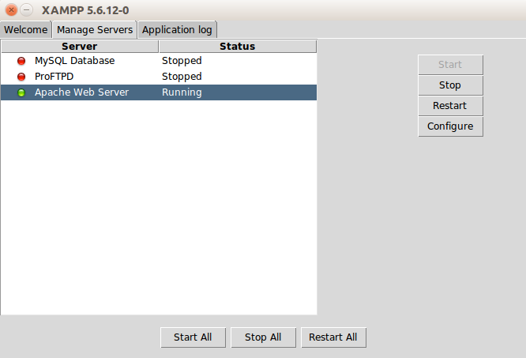
Start XAMPP
Notes:
/opt/lampp/lampp start

Slide 19
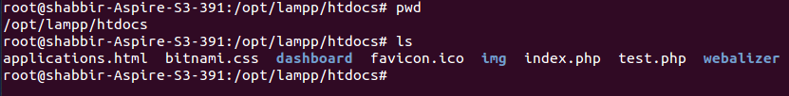
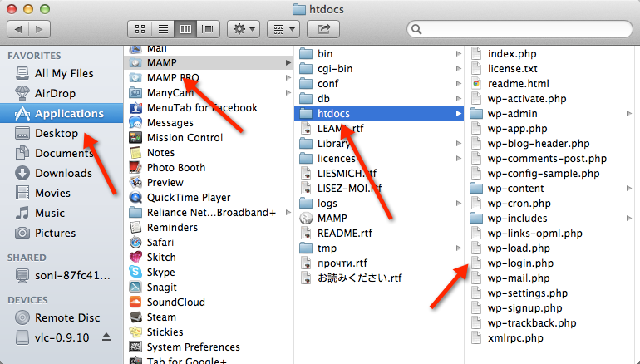
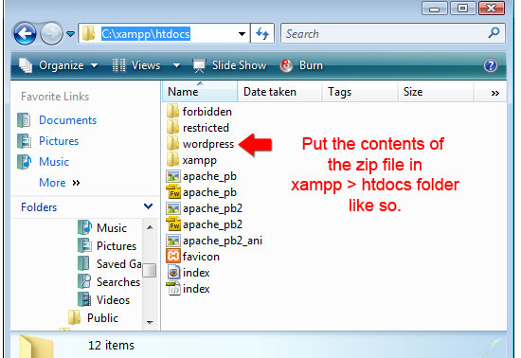
Go to htdocs
Notes:
Source: http://en.wikipedia.org/wiki/Model%E2%80%93view%E2%80%93controller#mediaviewer/File:MVC-Process.svg
<number>

Slide 20
References
Java Game Tutorial: http://zetcode.com/tutorials/javagamestutorial/
Java Group layout:https://docs.oracle.com/javase/tutorial/uiswing/layout/group.html

